Slide 1


Automate Accelerate
& Scale IT for business
Cloud, Digital Transformation, IoT
Paris, London, Sophia Antipolis, San Jose, Dakar

Slide 2
Content
Objective
Data Streaming Platform (Kafka-Storm-Visdom)
Architecture
Execution in PCA (ProActive Cloud Automation)
Dataflow Sample
Overview
Workflow description
Workflow execution
Result visualization
Pros of Data Streaming with (ActiveEon) ProActive

Slide 3
Objective
We aim at demonstrating how easy and efficient to perform real-time data stream processing using ActiveEon ProActive.
We use a data streaming platform composed of:
Apache Kafka: A distributed streaming platform (https://kafka.apache.org/)
Apache Storm: A distributed real-time computation system (http://storm.apache.org)
Visdom: A tool for creating, organizing, and sharing visualizations of live, rich data (https://github.com/facebookresearch/visdom)

Slide 4
Data Streaming Platform Kafka-Storm-Visdom

Slide 5


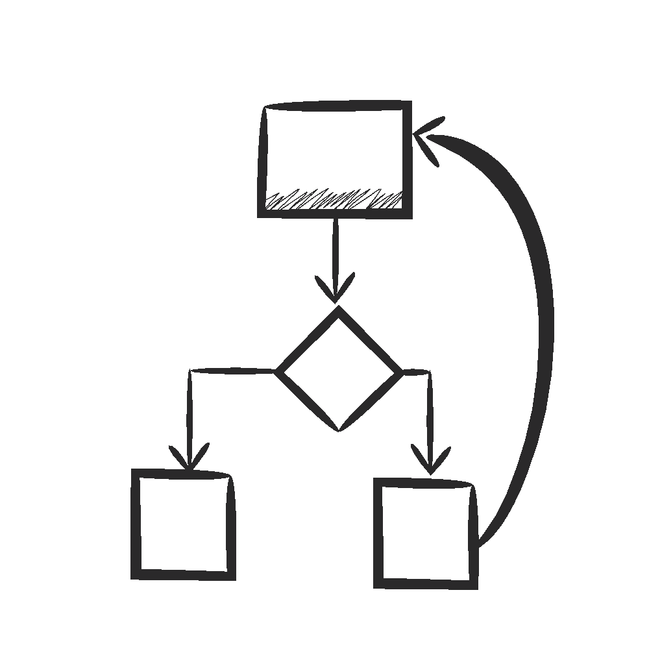



Data Streaming Platform - Architecture
Message brokering
Stream processing
Visualization
Data streaming workflows
Business Dataflow
Visdom
ProActive
Data Space
ProActive
Data Space
Business libraries
Scheduler
Stream Processing Engines
Resource Manager
Physical, virtual, private, public resources

Slide 6
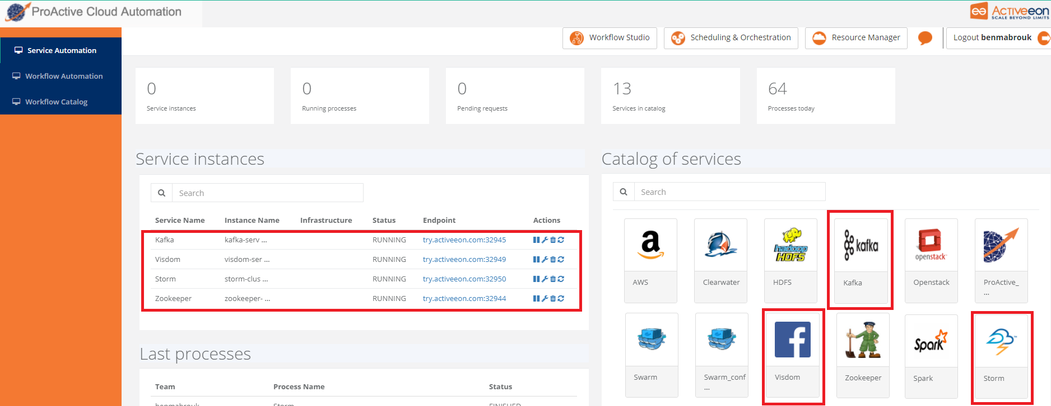
Data Streaming Platform in PCA
In ProActive Cloud Automation (PCA), we created workflows for creating and removing instances of Apache Kafka, Apache Storm and Visdom.

Slide 7
Dataflow Sample

Slide 8

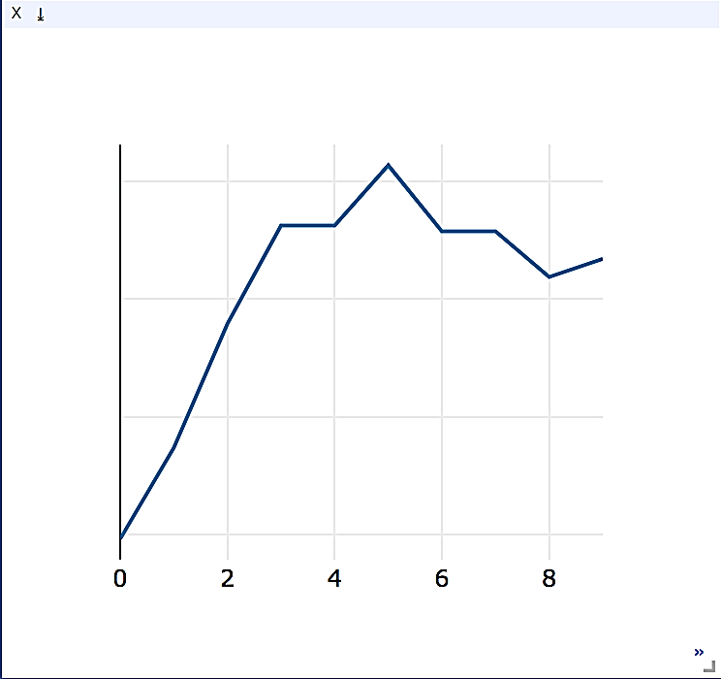

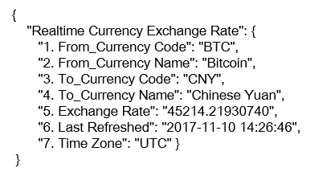
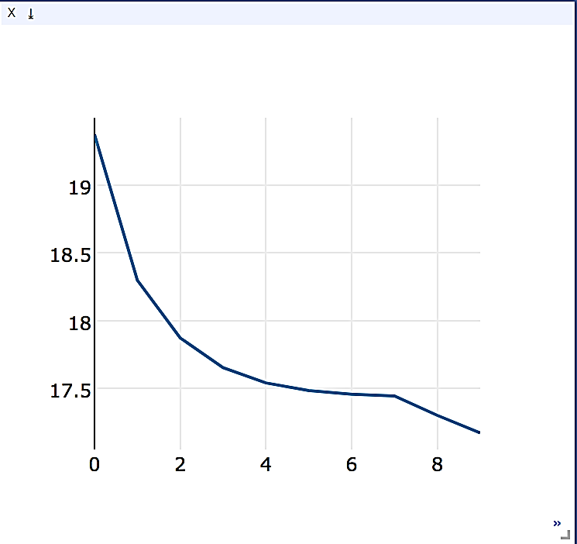
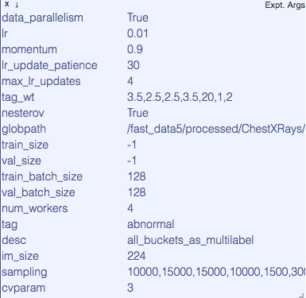

Dataflow Sample - Bitcoin to Yuan rate processing
Online real-time data
Kafka broker
Storm topology
Kafka broker
Visdom
Bitcoin rate topic
Kafka Producer (rates)
Bitcoin to Yuan raw data
Raw data topic
Rate variations topic
Kafka
Spout
Data Processing
Kafka Producer (variations)
Notifications topic
Kafka Producer (notifications)
We acquire real-time data about the exchange rate of Bitcoin to the Chinese Yuan.
This data is available online in a json format. Each json message is stored in a Kafka publish-subscribe topic.
We further deploy a topology (i.e., a dataflow application) in storm, which:
(i) reads json messages from the kafka topic,
(ii) parses the json structure,
(iii) extracts the exchange rate,
(iv) computes the rate variations,
(v) sends a notification if the variation is greater than 50 Yuan.
The extracted rate, variations and notifications are sent to Kafka topics, and further visualized via Visdom.

Slide 9
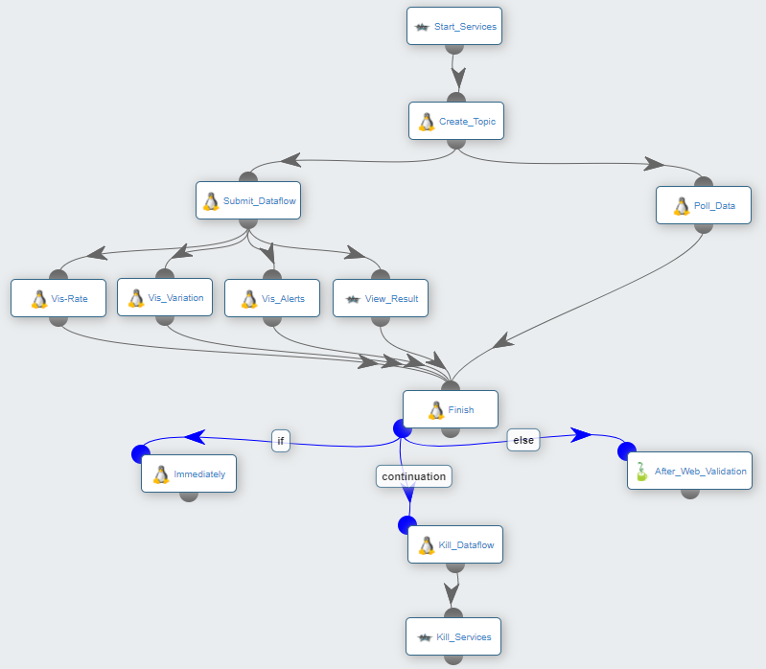
Dataflow Sample – Workflow overview
Start PCA services (Kafka, Storm and Visdom)
1
1
Create a topic in Kafka to receive Bitcoin raw data
2
2
Acquire Bitcoin raw data available online and send it to the created topic in Kafka
4
3
3
5
Submit the dataflow (jar) code to Storm. The processed data will be sent to some Kafka topics
4
6
Acquire processed data from Kafka topics and send it to Visdom for visualization
5
Remove the dataflow and PCA platforms, either immediately, or after a web validation
6

Slide 10
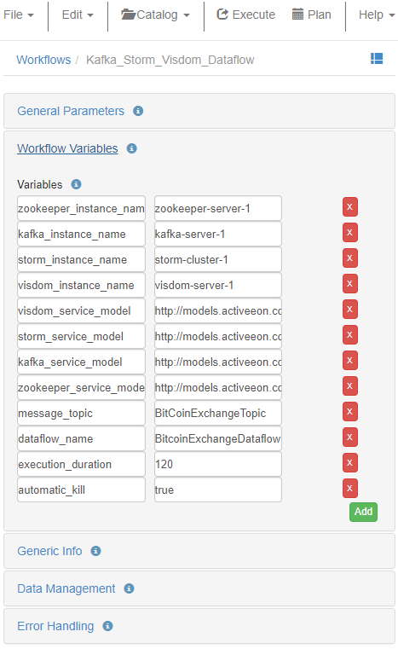
Dataflow Sample – Workflow execution
2
Configure key workflow parameters
execution_duration: The execution duration of the dataflow
Default 120 seconds
automatic_kill: Automatic kill of the dataflow and PCA platforms.
if set to true, the dataflow and PCA platforms are immedialtely removed after elapsing the execution duration. Otherwise, a web notification is sent to the user, and an acknowldgement is required to remove the running dataflow and PCA platforms.
1
Launch the dataflow
2
1

Slide 11
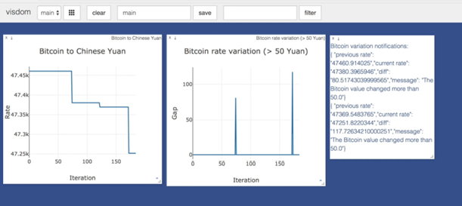
Dataflow Sample – Result visualization

Slide 12
Summary

Slide 13
Pros of Data Streaming with ProActive
Deploy/undeploy complex big data platforms in One Click
Loose coupling and easy integration between big data platforms using ProActive Dataspaces and Endpoints
Schedule big data workloads and manage resources efficiently
Fault tolerance and recovery for business dataflows

Slide 14






Automate Accelerate & Scale IT for business
Automate Accelerate & Scale IT for business
Activeeon SAS Paris, Sophia Antipolis & San Jose, London, Dakar with
Azure, AWS, and Google cloud
+33 988 777 660
contact@activeeon.com
@activeeon

